Slide 1
São Paulo City | Average Rental Prices & Venues Analysis

Slide 2
Where?
São Paulo

Slide 3
Context
São Paulo is the foremost industrial centre in Latin America;
The city sits in a shallow basin with low mountains to the west;
The city of São Paulo proper had a population of more than 10 million, and the metropolitan region had soared to about 19 million inhabitants;
Area city, 576 square miles (1,493 square km).

Slide 4

I selected 74 most famous boroughs to explore!

Slide 5
Business Problem
São Paulo has a high population density and crowded cities tends to receive a lot of shops and social areas.
Workforce point of view:
lower rental cost
social places density (venues)
locations as close to downtown as possible

Slide 6
BIG CONCEPT
Create a Map and charts in order to place where the rental prices are and how each borough is clustered according to the venue density

Slide 7
Data Ingestion
IBGE
Foursquare API
Web Pages
Important Considerations
Geospatial Data
Venues Data
Rental Prices
Standard Apartment for Rent
The .csv file has coordinates of all cities from Brazil. First, I cleaned the data and reduced it to data only from São Paulo city
Venues data were obtained from Foursquare API, to explore restaurants, hotels, stores, their type and location in every borough
It’s a challenge to find public data Sometimes, you must set-up your own data tables . In this case, I collected latest House Rental Prices Averages from web pages.
It was considered a standard apartment for rental, as it follows: until 1-2 bedrooms, 1 garage, 70 m2. It was chosen because the focus is on early professional necessity

Slide 8
1.
Methodology
This project uses some data science powers to generate a few most promising boroughs
Best possible final location can be chosen by workers!

Slide 9
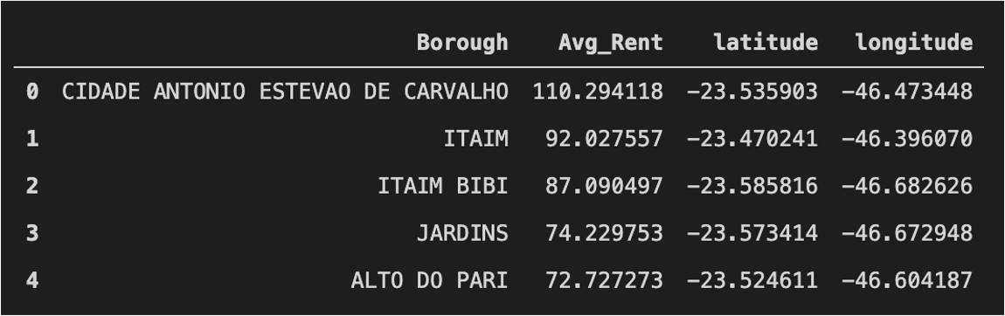
Master Data
Main components:
Borough,
Average Rental prices,
Latitude and
Longitude
of São Paulo City

Slide 10
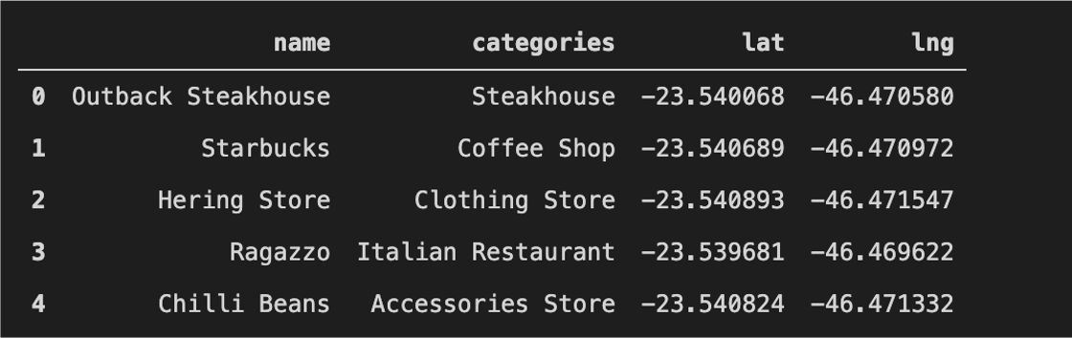
Foursquare Venues
Foursquare API explored the boroughs and segment them according to its venues.
The limit was 100 venues and the radius 750 meters for each Borough, following their geometric coordinates information.

Slide 11
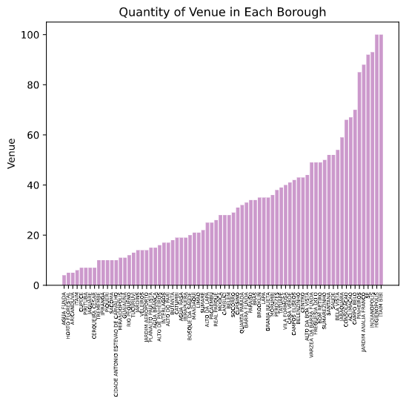
Itaim and Higienópolis boroughs reached the 100 limit of venues!
We can observe that 263 venues categories were returned by Foursquare. This merged table below show us boroughs and venues together:

Slide 12
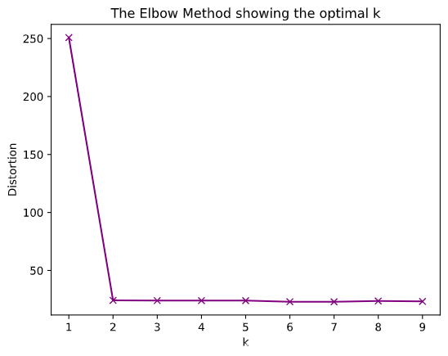
K-means algorithm
Unsupervised learning method
Common venue categories in boroughs.
But, how can I discover cluster quantity?
Elbow method: when the function gets flat, it's when my K number is optimum

Slide 13
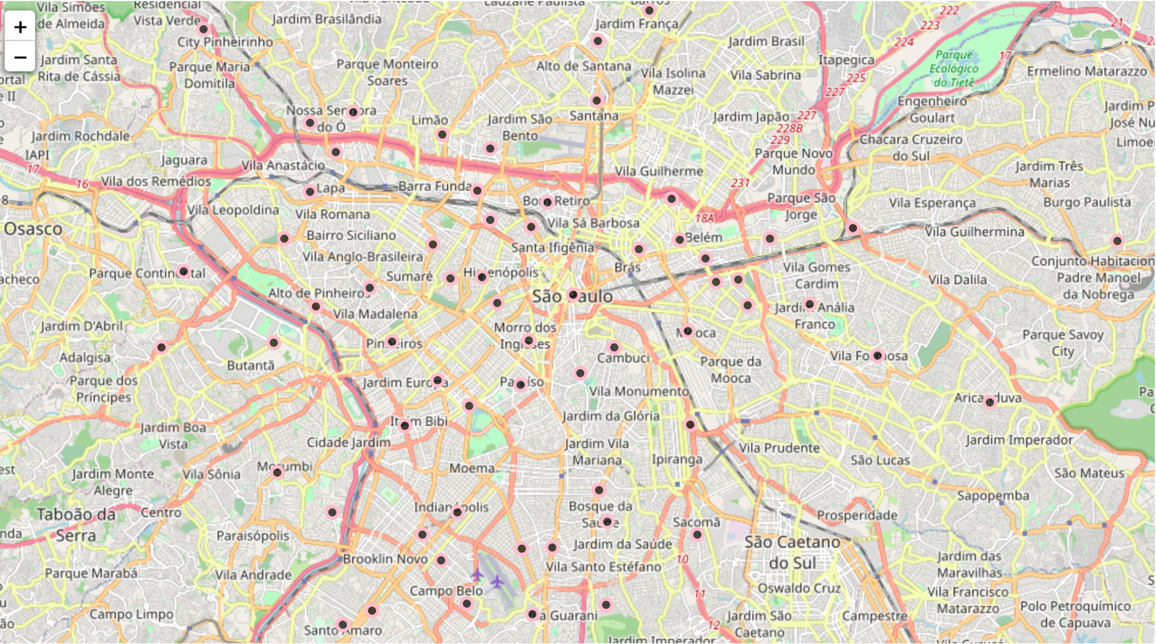
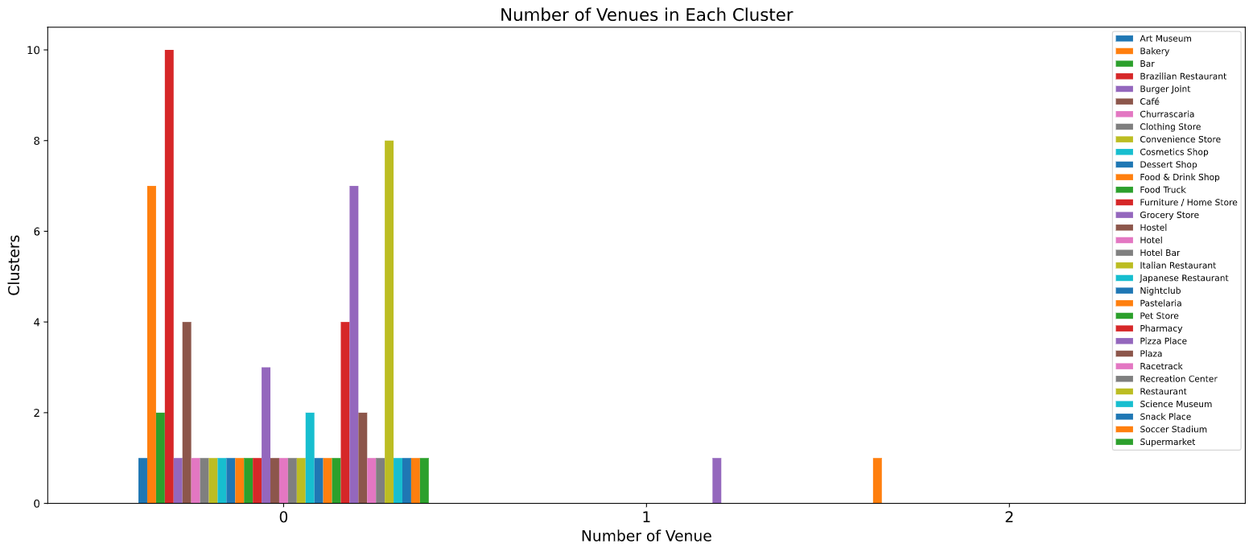
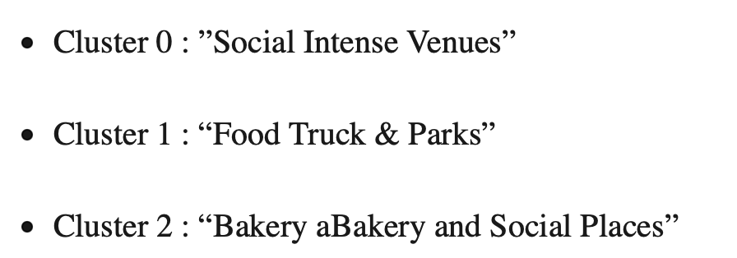
1st Most Common Venues

Slide 14
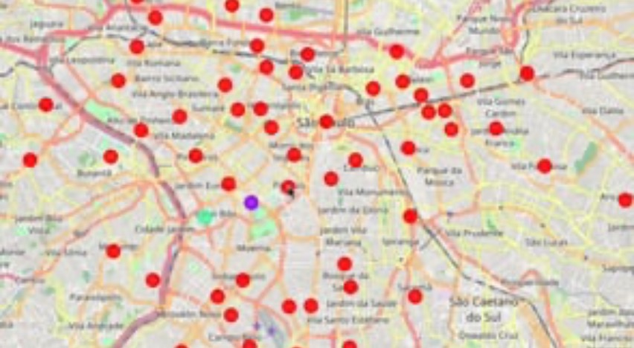
About the Classification of Local Businesses (Venues)

Slide 15

About Rental Values and Regions

Slide 16
IN TWO OR THREE COLUMNS
Venues
the vast majority of districts are grouped in the same cluster. This shows us that the city of São Paulo presents a certain homogeneity in the distribution of its establishments among the main neighborhoods.
Rental Prices
It was noticed that the closer the district is to the geographic coordinates of the central point of the city of São Paulo, the higher the rent values.

Slide 17
Finally, young people are moving to large centers in search of opportunities and new businesses.
For this reason, people can gain power of choice when they can access data across platforms.
Provide major city managers and entrepreneurs to support them in decisions and future investments.

Slide 18
THANKS!
Carolina Martão
You can find me at:
@carolmartao on GitHub

